Slide 1
Basic Approaches
Leadership

Slide 2

Leadership – Management : What’s the Difference?
Leadership
The ability to influence a group toward the achievement of goals or a vision….Direction
Management
Use of authority inherent in designated formal rank to obtain compliance from organizational members.
Plan- Organise – Monitor

Slide 3
Leadership Theories
Trait (up to late 1940s)
  Theories that consider personality, social, physical, or intellectual traits. (leaders are born, not made)
Behaviour (until late 1960s)
  Theories proposing that specific behaviors differentiate leaders from non-leaders. (Leadership traits can be taught.)
Contingency (current dominant approach)
  Theories that situational factors impact leadership effectiveness.

Slide 4
Trait Theories
Nelson Mandela, Steve Jobs, Margaret Thatcher, Richard Branson – recognised as charismatic, enthusiastic, courageous leaders
Researchers are continuously searching for the trait mix that will make for an effective leader.
Very difficult to isolate the leaders’ traits...until Big 5
Extraversion (ambition & energy) appears to be an important trait for emerging (not effective) leaders
Conscientious (ability to be disciplined and keep commitments)
Recent studies say Emotional Intelligence (EI) is an important trait for effective leadership
A person can have training, great analytical mind, a compelling vision and endless supply of ideas ….but without EI ….may not make a great leader

Slide 5
Trait Theories
Note…..:
Traits can often predict leadership…[Big 5].
No universal traits found that predict leadership in all situations.
Better predictor of the appearance of leadership than distinguishing effective and ineffective leaders.

Slide 6
Behavioural Theories [1940s – 60s]
Is there some unique behaviour among leaders?
Some leaders are tough talking, autocratic, intense …..Is that the preferred leadership style?
While Trait theory basis = ‘selecting’ the ‘right person’ for the job …. Behavioural theory would say…We can ‘Train’ people for positions of leadership
…Programmes can be designed to implant these behaviours into potential individuals for positions of leadership = endless supply of effective leaders

Slide 7
Behavioural Theories [1940s – 60s]
Is there some unique behaviour among leaders?
Ohio State Studies (in late 1940s)
Aim: to identify independent dimensions of leader behaviour began with over 1000 dimensions, narrowed to two dimensions
  Initiating Structure:
  Extent to which a leader is likely to define and structure his/her role and that of employees in the search for goal attainment
  Behaviour that tries to organise work, relationships and goals
  Application: The leader assigns group members to tasks, expect definite standards of performance, emphasise meeting of deadlines

Slide 8
Behavioural Theories [1940s – 60s]
Is there some unique behaviour among leaders?
Ohio State Studies (in late 1940s)
  Consideration:
  Extent to which a person will have job relationships characterised by mutual trust, respect for employee ideas, regard for their feelings, their comfort, well being, satisfaction, treats all employees as equals, is approachable
  Leader with Consideration would help employees with their personal problems, is friendly, approachable, ….

Slide 9
Behavioral Theories
University of Michigan (similar to Ohio)
Came up with two dimensions
  Production Oriented
  Emphasized on the task or technical aspect of the job – their main concern was task completion – employees were just a means to an end
  Employee Oriented
  Such leaders emphasize inter personal relations
Initiating structure is similar to production oriented while consideration is similar to employee oriented.
As a result most leadership researchers use these terms interchangeably.

Slide 10
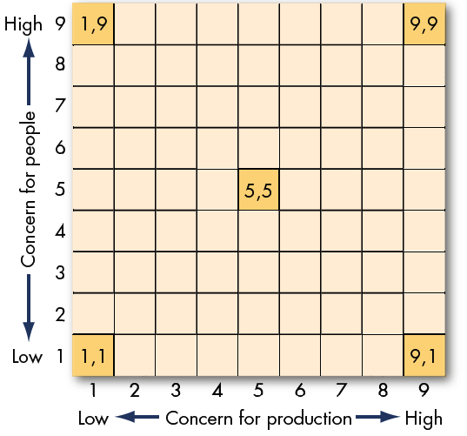
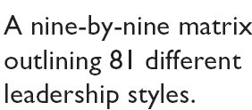
The Managerial Grid
(Blake and Mouton)
End result?
Nothing new to add to Ohio or Michigan research

Slide 11
Contingency Theories
Example: Linda Wachner of Warnaco
Fiedler’s Contingency Model
Hersey and Blanchard’s Situational Leadership
Leader Member Exchange Theory
Path Goal Theory
Leader Participation Theory

Slide 12

Contingency Theories
Fiedler’s Contingency Model
The theory proposes that effective group performance depends on a proper match between a leader’s style of interacting with subordinates and the degree to which the situation gives control and influence to the leader.
Fiedler believed that a key factor to leadership success is an individual’s leadership style.
So he begins to find out what that basic style is.
Result : Least Preferred Co-worker questionnaire

Slide 13
Contingency Theories
Least Preferred Co-Worker (LPC) Questionnaire
An instrument that seeks to measure whether a person is task-oriented or relationship-oriented.
Contains 16 contrasting adjectives (e.g. pleasant – unpleasant, supportive-hostile, etc.)
Ask person to describe the ‘one person’ they least enjoyed working with on a scale of 1 to 8
A high LPC score implies you’re ‘relationship oriented’
A low LPC score indicates ‘task oriented’.
About 16% fall in neither category
Fiedler’s assumption: An individual’s leadership style is fixed.
Thus, it is necessary to match the leader with the situation

Slide 14
Findings from Fiedler’s model
Application:
Change leader to fit the situation
Change situation to fit the leader
Fiedler’s assumption:
Leadership style is fixed

Slide 15
Fiedler Model
Effective group performance depends on the proper match between leadership style and the situation
  Assumes that leadership style (based on orientation revealed in LPC questionnaire) is fixed
Considers Three Situational Factors:
  Leader-member relations: How much confidence and trust people have in the leader
  Task structure: degree of structure in the jobs, procedurised
  Position power: leader’s influence in areas of hiring, firing, discipline, promotion and salary increase
  For effective leadership: Change to a leader who fits the situation or change the situational variables to fit the current leader
© 2009 Prentice-Hall Inc. All rights reserved.
12-<number>

Slide 16
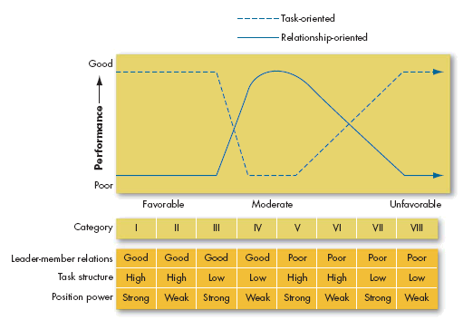
Graphic Representation of Fiedler’s Model
Used to determine which type of leader to use in a given situation
© 2009 Prentice-Hall Inc. All rights reserved.
12-<number>

Slide 17
Paul Hersey and Ken Blanchard’s
Situational Leadership Theory
A contingency theory that focuses on followers’ readiness.
Viz. Successful leadership is achieved by selecting the right leadership style which is dependent on the level of the followers’ readiness.
question: Why focus on the follower and what is the meaning of readiness?
It is the follower who accepts or reject the leader
Readiness refers to the extent to which people have the ability and willingness to accomplish a specific task.
SLT views Leader – Follower relationships as analogous to Parent – Child relationship

Slide 18
Hersey and Blanchard’s Situational Leadership Theory
H&B identified four specific leader behaviour – from Highly Directive to Highly Laissez-faire
Unable and
Unwilling
Unable but
Willing
Able and
Unwilling
Able and
Willing
Follower readiness:
ability and willingness
Leader: decreasing need
for support and supervision
Directive
High Task and Relationship Orientations
Supportive Participative
Monitoring

Slide 19
Leadership Styles and Follower Readiness
(Hersey and Blanchard)
SLT has an intuitive appeal – since it acknowledges the importance of followers and builds on the logic that leaders can compensate for ability and motivational limitations in their followers.

Slide 20

Leader–Member Exchange Theory
Leader-Member Exchange (LMX) Theory
Because of time pressures, leaders establish a special relationship with a small group of their followers.
These individuals are trusted, get the leader’s attention, receives special privileges
Leaders create in-groups and out-groups, and subordinates with in-group status will have higher performance ratings, less turnover, and greater job satisfaction.
How do leaders choose in-group members?
Suggestions ….attitude, personality, competence similar to that of the leader
Note: Even though it is the leader who is choosing, it is the follower's characteristics that is driving this choice

Slide 21
LMX Theory….
There is a danger to being apart of the inner circle…
  Your fortunes may rise and fall along with your leader

Slide 22

Path-Goal Theory (Robert House)
Path-Goal Theory
The theory suggests that it is the leader’s job to assist followers in attaining their goals and to provide them the necessary direction and/or support to ensure that their goals are compatible with the overall objectives of the group or organization and that leaders can display multiple leadership styles

Slide 23
Path-Goal Theory (Robert House)
House identified four leadership bahaviour:
Directive leaders: lets followers know what is expected of them, schedules work to be done, gives guidance on how to ...
Supportive leaders : friendly and shows concern for the needs of followers
Participative leaders: Consults with followers and uses their suggestions before making a decision
Achievement oriented: sets challenging goals, expects followers to perform at highest level
House assumes leaders are flexible and can display any or all behaviours to match the situation

Slide 24

Leader-Participation Model
Leader-Participation Model (Vroom and Yetton)
Related to leadership behaviour and participation in decision making.
Argues that leader behaviour must adjust according to the task structure
A leadership theory that provides a set of rules to determine the form and amount of participative decision making in different situations.

Slide 25
Contingency Variables in the Revised
Leader-Participation Model
Lone decision of leader
Importance of the decision
Importance of obtaining follower commitment to the decision
Whether the leader has sufficient information to make a good decision
How well structured the problem is
Whether an autocratic decision would receive follower commitment
Whether followers “buy into” the organization’s goals
Whether there is likely to be conflict among followers over solution alternatives
Whether followers have the necessary information to make a good decision
Time constraints on the leader that may limit follower involvement
Whether costs to bring geographically dispersed members together is justified
Importance to the leader of minimizing the time it takes to make the decision
Importance of using participation as a tool for developing follower decision skills
Consensus decision
Stress, intelligence and experience are important situational variables. The LP Model does not include these.

